Slide 1
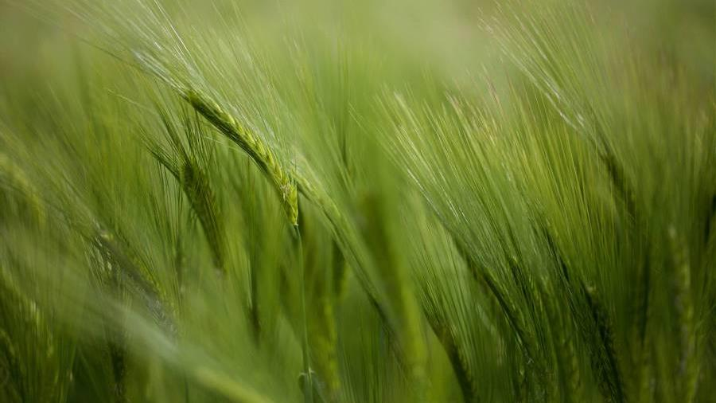
Car Racing Game
BY: Zain Ali Shah(04162013020)
Aleesha Zainab(04162013021)

Slide 2

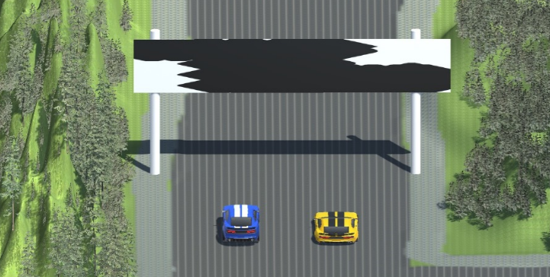
Game Story
The new street racers, eager to prove themselves in the world of underground racing.
Two cars, one road, and the one who takes more laps wins.
The racer decides to enter the race, and they find themselves lined up at the starting line with opponent.

Slide 3
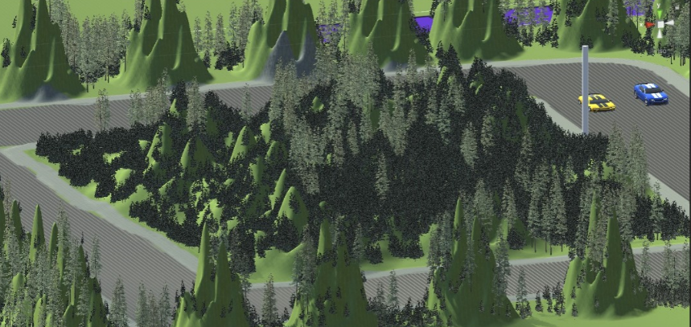
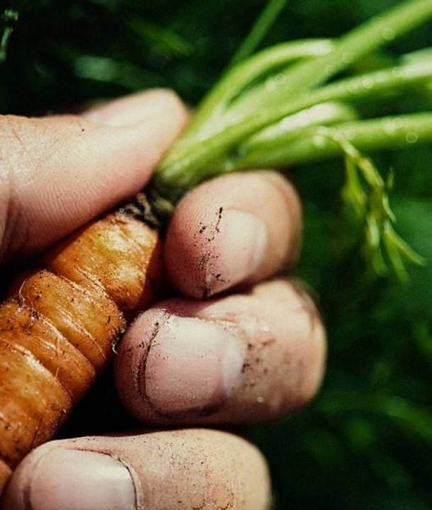
Environment
The road is narrow and treacherous
sharp turns and steep cliffs
Road surrounded by dense forests and cliffs
Careful not to crash cars into the surrounding small cliffs.

Slide 4
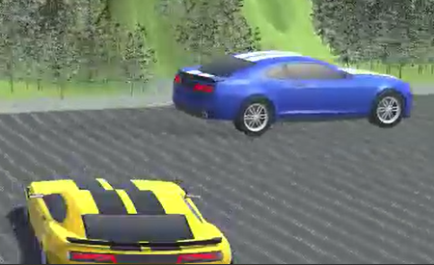
Characters
There are two characters
One character is the racer who is trying to improve his racing skills
Other character is the opponent player who is programmed to defeat the racer.

Slide 5
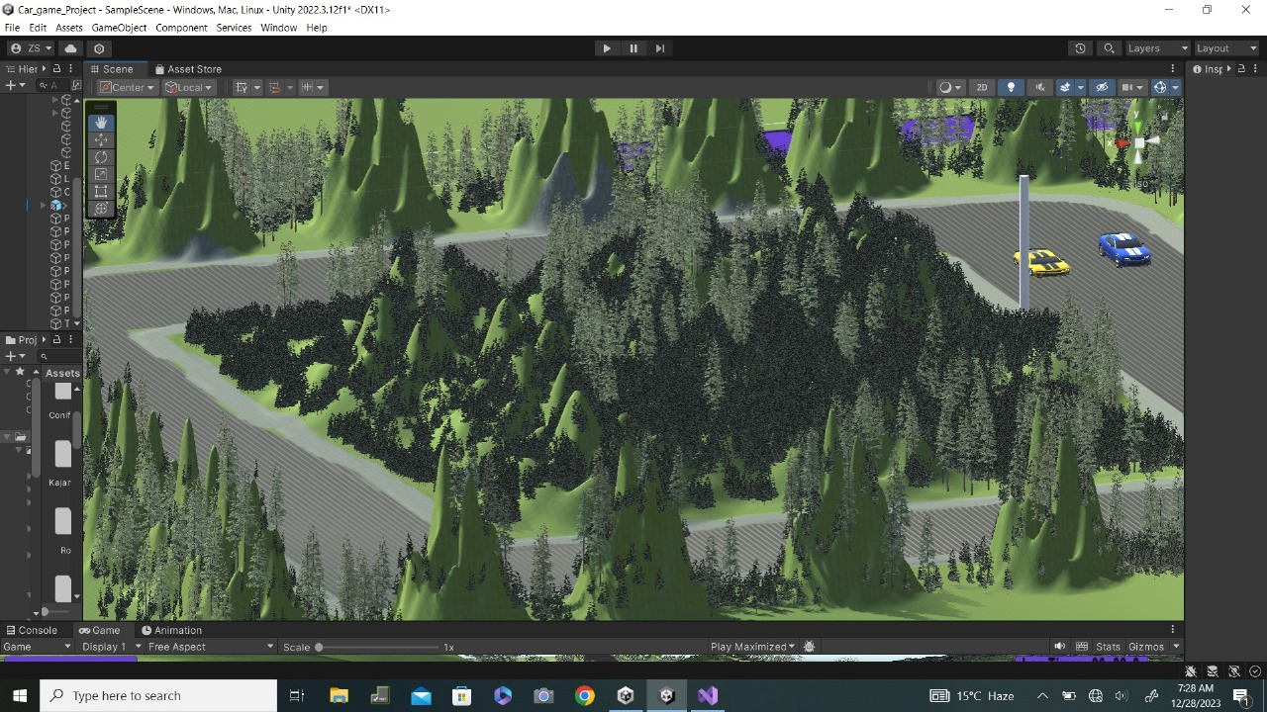
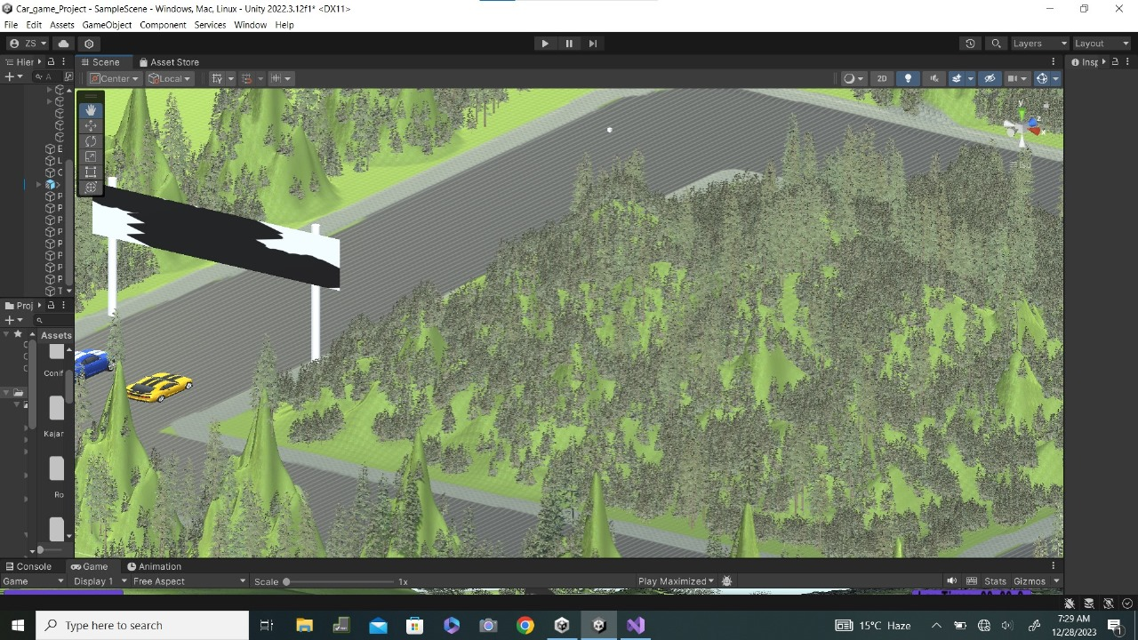
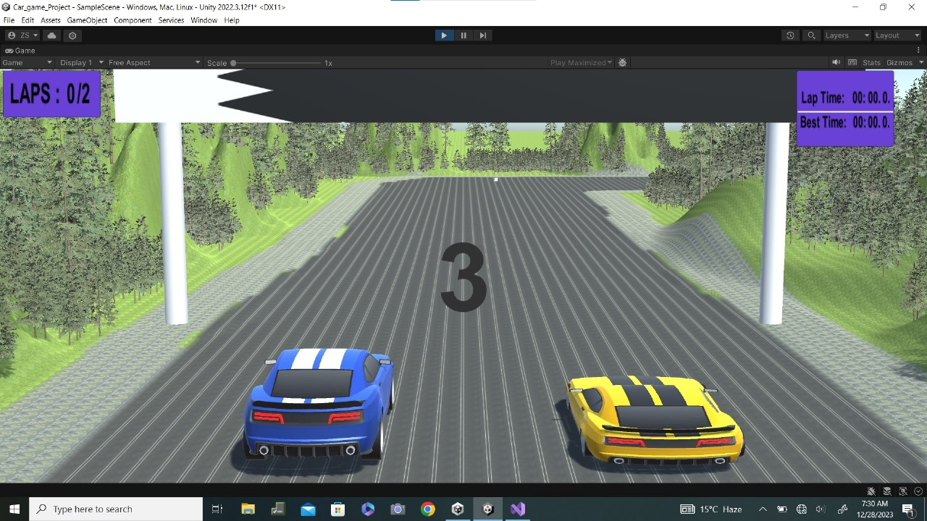
Game Screenshots

Slide 6
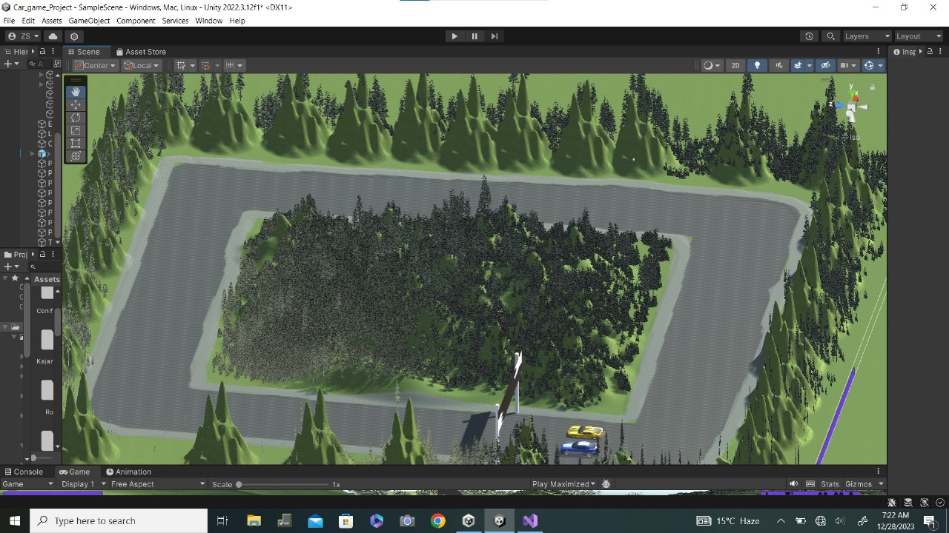
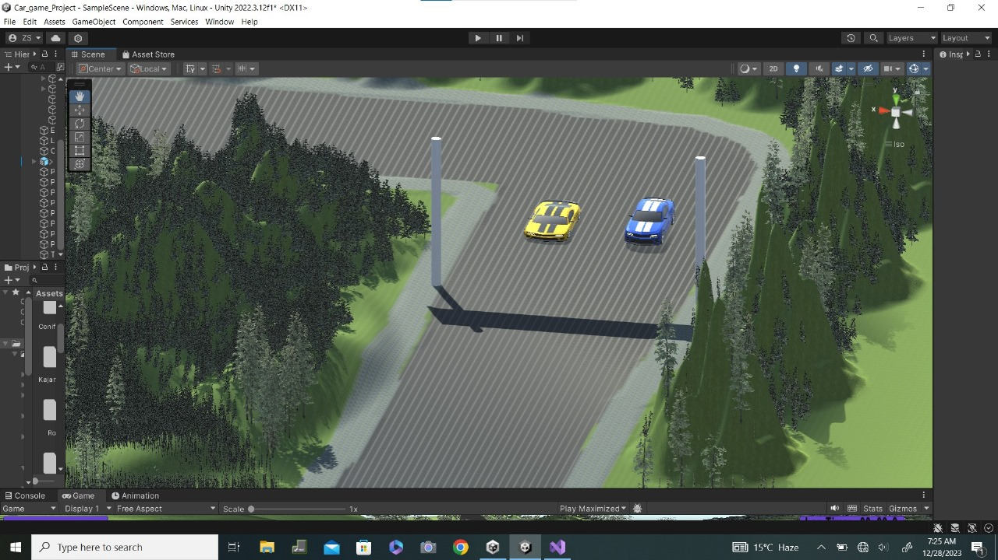
Game Screenshots

Slide 7
Language(C#) and Code:

Slide 8
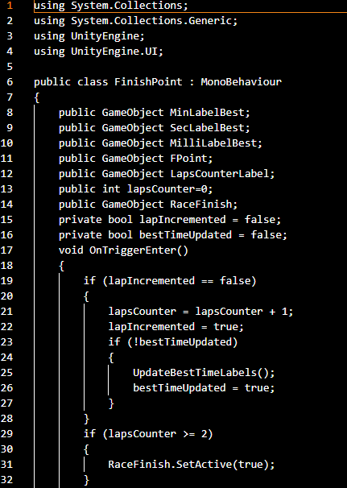
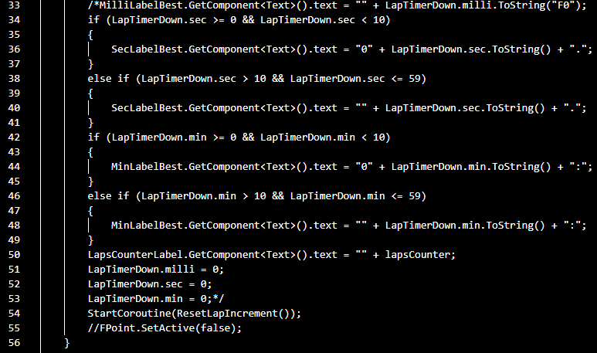
Finish POINT Code
Close the gap
Target audience
Our product makes organic farming easier, and no other product on the market offers the same benefits or yield.
Gen Z (18-25 years old)
Cost savings
Easy to use
Reduce expenses for replacement products
A simple product that gives customers the information they need in order to produce an abundance of rich produce

Slide 9
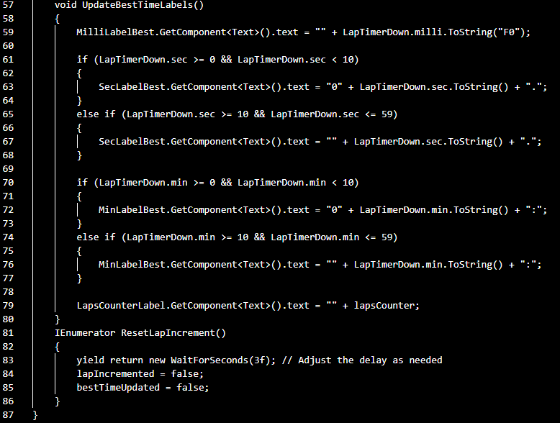
Finish Point Code
Close the gap
Target audience
Our product makes organic farming easier, and no other product on the market offers the same benefits or yield.
Gen Z (18-25 years old)
Cost savings
Easy to use
Reduce expenses for replacement products
A simple product that gives customers the information they need in order to produce an abundance of rich produce

Slide 10
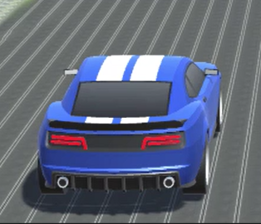
AI CAR

Slide 11
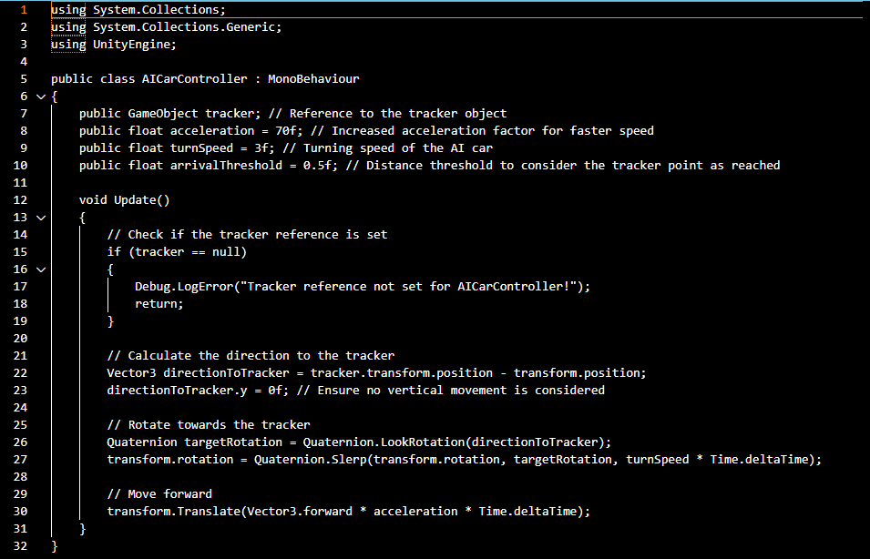
AI Car Controller Code
Close the gap
Target audience
Our product makes organic farming easier, and no other product on the market offers the same benefits or yield.
Gen Z (18-25 years old)
Cost savings
Easy to use
Reduce expenses for replacement products
A simple product that gives customers the information they need in order to produce an abundance of rich produce

Slide 12
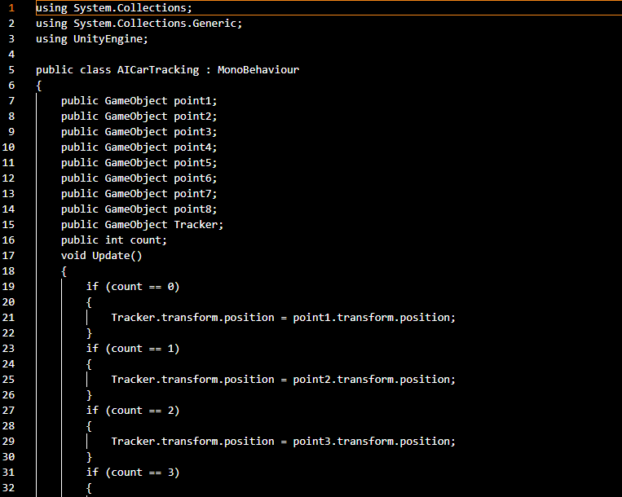
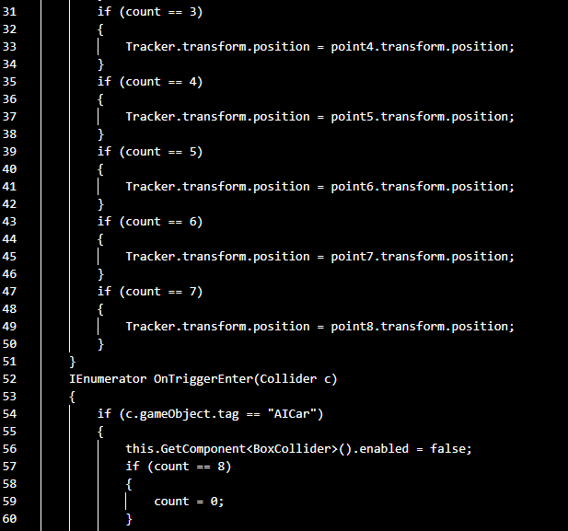
AI Car Tracking
Close the gap
Target audience
Our product makes organic farming easier, and no other product on the market offers the same benefits or yield.
Gen Z (18-25 years old)
Cost savings
Easy to use
Reduce expenses for replacement products
A simple product that gives customers the information they need in order to produce an abundance of rich produce

Slide 13
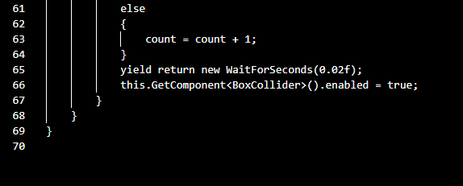
AI Car Tracking
Close the gap
Target audience
Our product makes organic farming easier, and no other product on the market offers the same benefits or yield.
Gen Z (18-25 years old)
Cost savings
Easy to use
Reduce expenses for replacement products
A simple product that gives customers the information they need in order to produce an abundance of rich produce

Slide 14
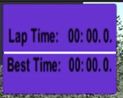
LAP Timer

Slide 15
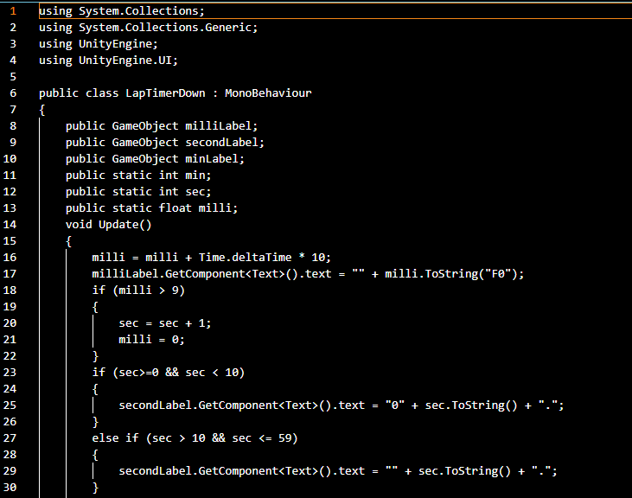
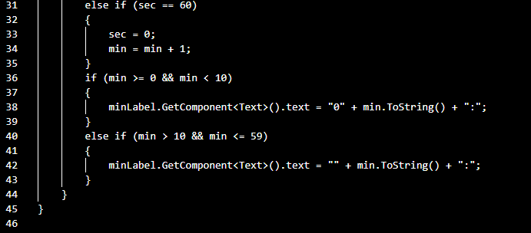
Lap Timer Down Code
Close the gap
Target audience
Our product makes organic farming easier, and no other product on the market offers the same benefits or yield.
Gen Z (18-25 years old)
Cost savings
Easy to use
Reduce expenses for replacement products
A simple product that gives customers the information they need in order to produce an abundance of rich produce

Slide 16
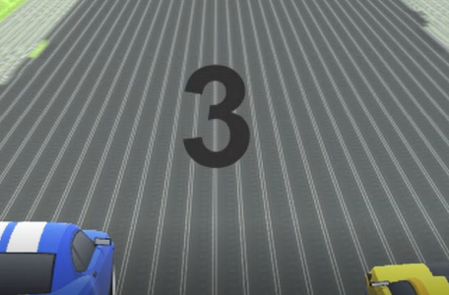
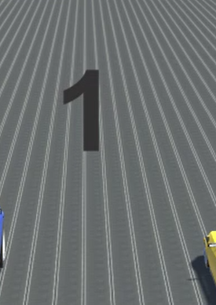
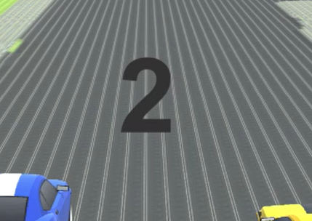
Counter

Slide 17
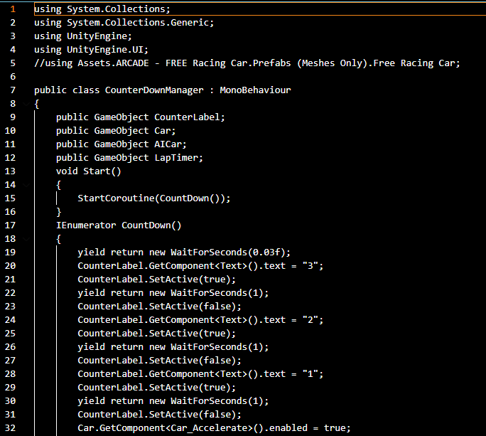
Counter Down Manager Code
Close the gap
Target audience
Our product makes organic farming easier, and no other product on the market offers the same benefits or yield.
Gen Z (18-25 years old)
Cost savings
Easy to use
Reduce expenses for replacement products
A simple product that gives customers the information they need in order to produce an abundance of rich produce

Slide 18
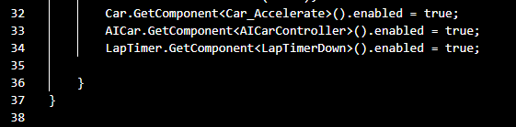
Counter Down Manager
Close the gap
Target audience
Our product makes organic farming easier, and no other product on the market offers the same benefits or yield.
Gen Z (18-25 years old)
Cost savings
Easy to use
Reduce expenses for replacement products
A simple product that gives customers the information they need in order to produce an abundance of rich produce
Notes:
Counter Down Manager

Slide 19
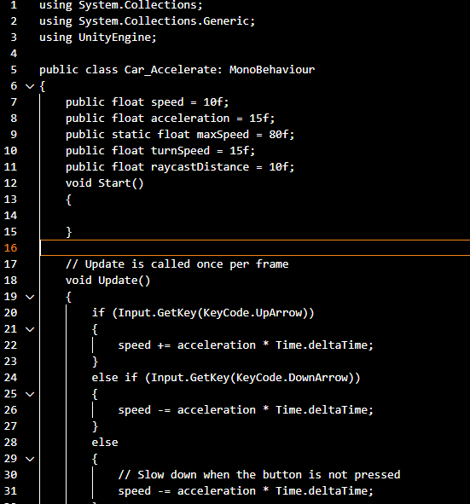
Car Accelerator
Close the gap
Target audience
Our product makes organic farming easier, and no other product on the market offers the same benefits or yield.
Gen Z (18-25 years old)
Cost savings
Easy to use
Reduce expenses for replacement products
A simple product that gives customers the information they need in order to produce an abundance of rich produce
Notes:
Counter Down Manager

Slide 20
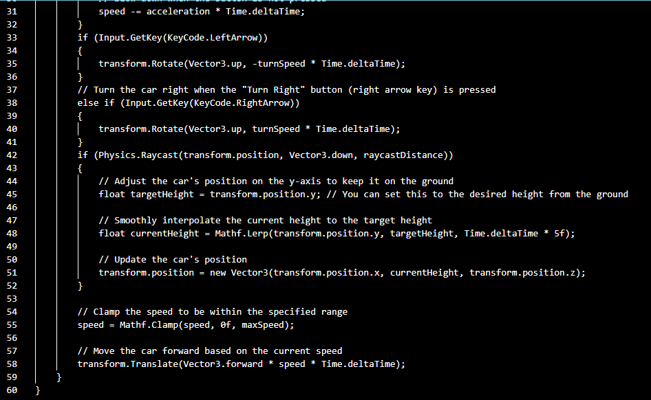
Car Accelerator
Close the gap
Target audience
Our product makes organic farming easier, and no other product on the market offers the same benefits or yield.
Gen Z (18-25 years old)
Cost savings
Easy to use
Reduce expenses for replacement products
A simple product that gives customers the information they need in order to produce an abundance of rich produce
Notes:
Counter Down Manager

Slide 21
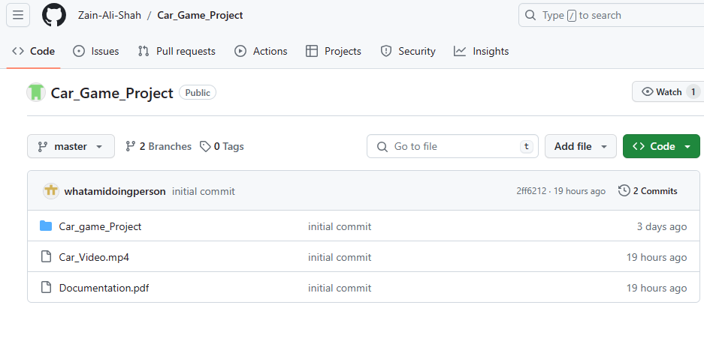
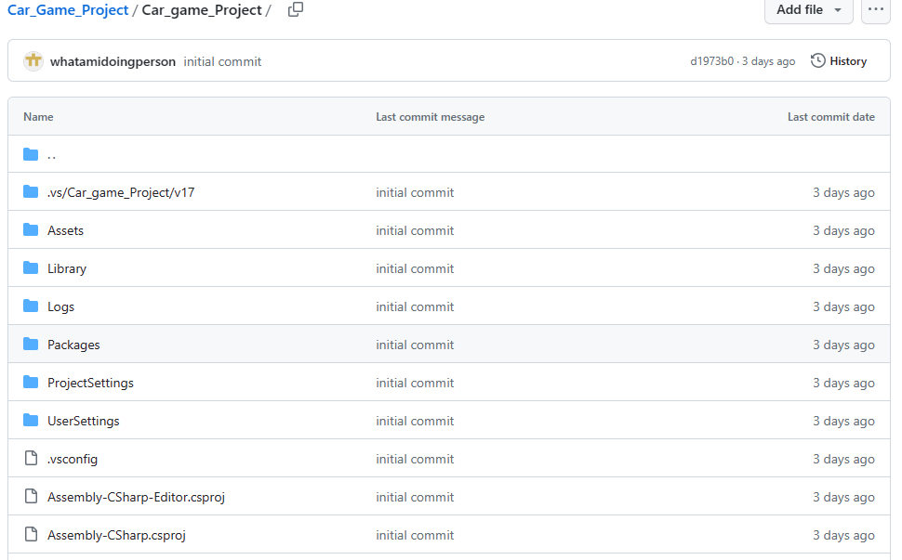
https://github.com/Zain-Ali-Shah/Car_Game_Project/tree/master

Slide 22
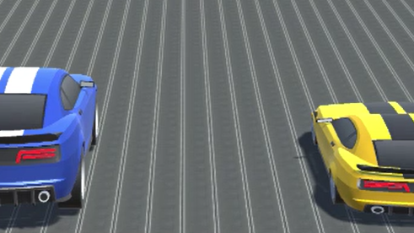
Thank YOU

